Slide 1
Building a secure user authorization story
Johnie J. karr
Code palousa
august 20, 2020

Slide 2

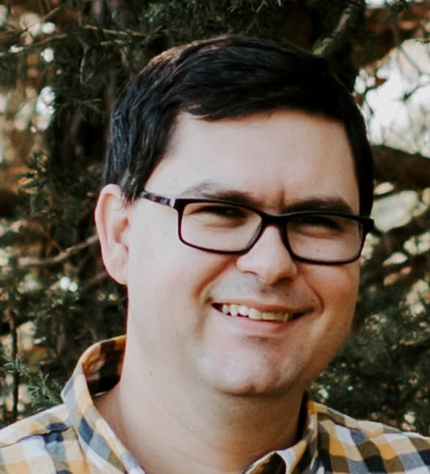
Who am i?
Senior Software Engineer
ScholarRx
Devoted
Husband, Father, Follower of Christ
johniekarr.wordpress.com
@dotNetPrgmr
linkedin.com/in/johniekarr
johnie.karr@hotmail.com

Slide 3
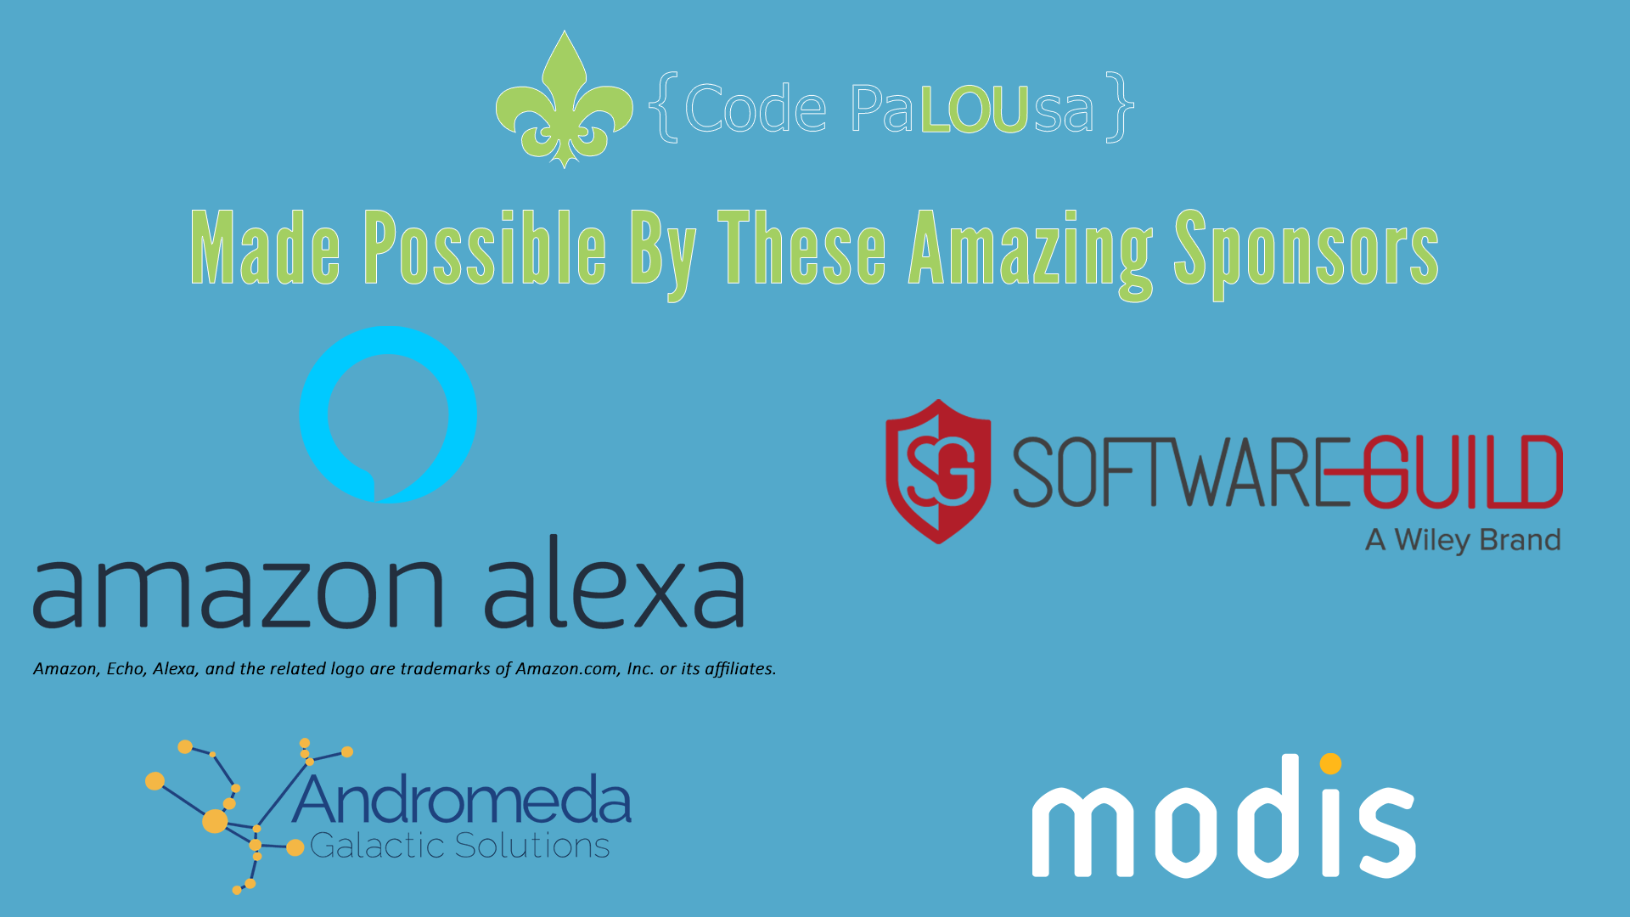

Slide 4
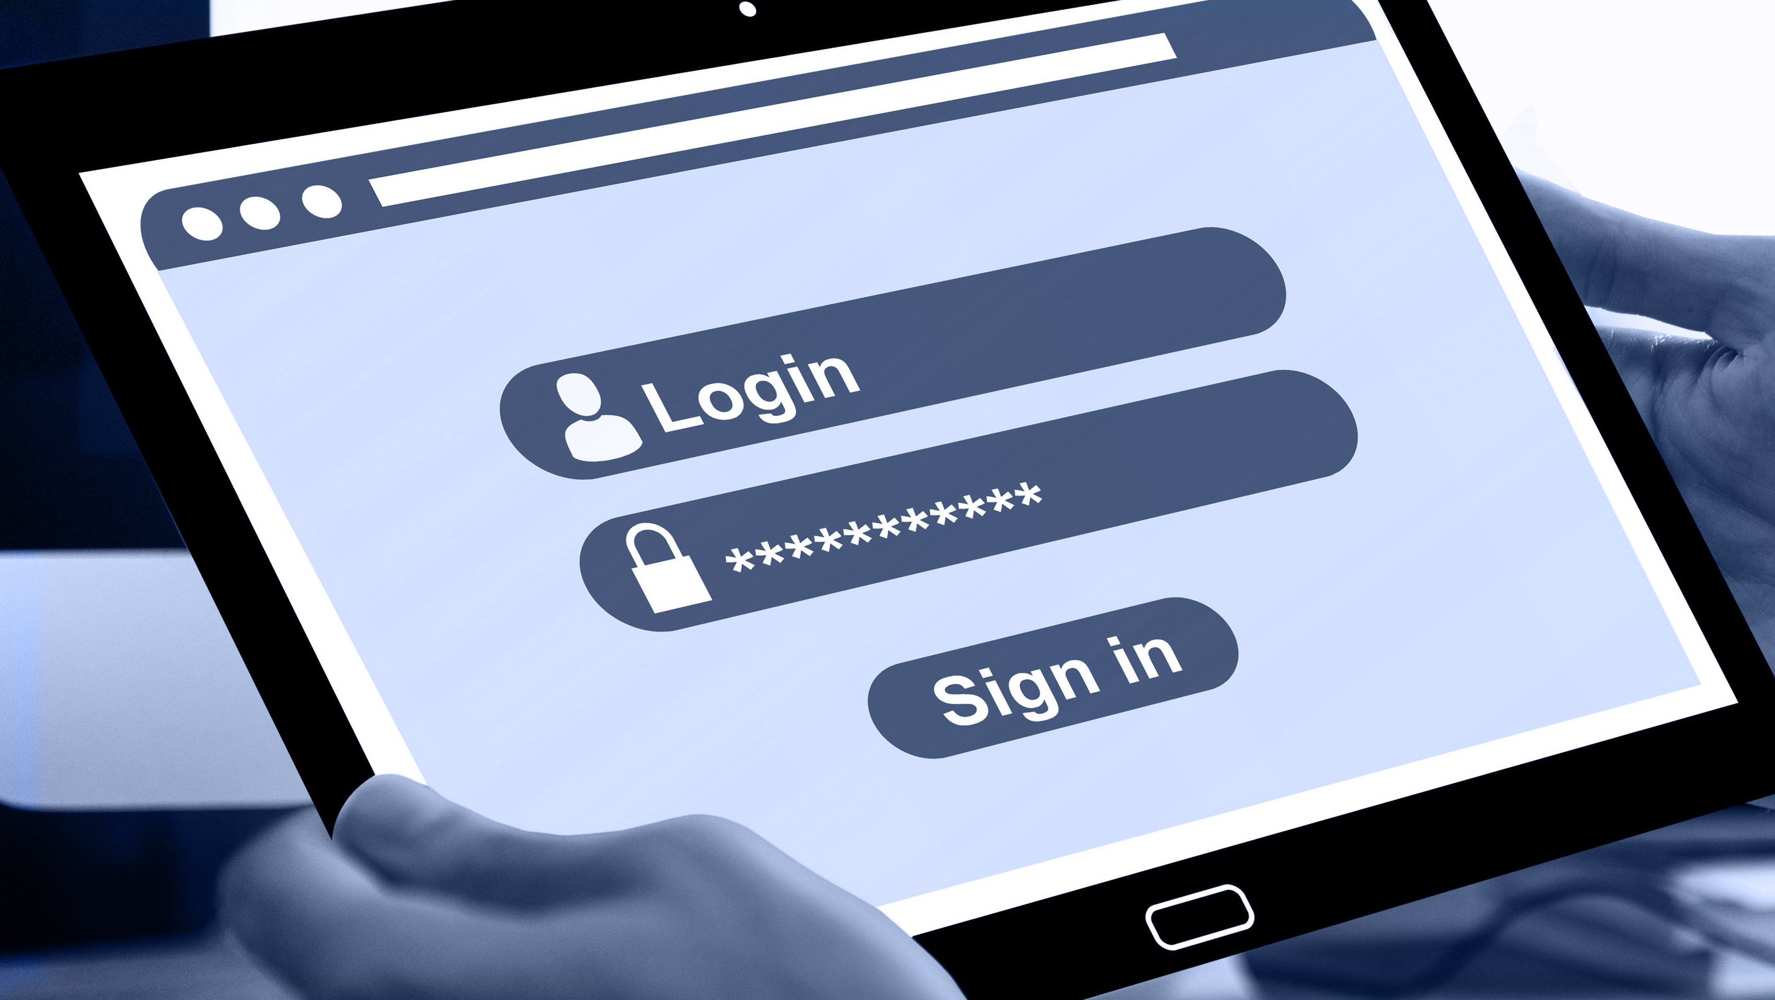
EVERY APPLICATION NEEDS AUTHENTICATION
HOW DO WE DO IT CORRECTLY?

Slide 5


Why is it important?
4.1 billion records stolen in first half of 2019
22,651,933 records stolen every day
On average, it takes 6 months to detect a breach
And another 55 days to contain a breach

Slide 6
How to handle passwords
Always encrypt passwords
Use policies that make sense
Work with password managers
Employ proper user workflow
Consider not using passwords at all

Slide 7
Always encrypt passwords
Technically, encryption isn’t enough, passwords should always be hashed
Encrypted strings can be decrypted. Hashes are one-way
Simple hashes aren’t good enough
Use a salt
Consider a pepper

Slide 8
Use policies that make sense
Good passwords are complex
Good passwords contain combinations of upper-case and lower-case letters and special characters and numbers
Good passwords are not re-used
Better passwords are pass phrases
Best passwords are randomly generated strings

Slide 9
Use policies that make sense
Do allow spaces
Don’t put an upper limit on the number of characters
Don’t put a limit on which special characters can be used
Don’t employ password expiration policies
Don’t use seemingly arbitrary password rules

Slide 10
Allow or disallow?
Not based on complexity
Based on time to crack
Based on if found in existing breach

Slide 11
demo
Using time to crack as a password strength indicator

Slide 12
demo
“Pwned Passwords” api

Slide 13
Work with password managers
Assume password managers make better passwords than your users
Don’t attempt to block paste
Don’t attempt to block context menu
Don’t attempt block automated DOM manipulation
Don’t use obscure names for password fields

Slide 14
Employ proper user workflow
Login page
Always use SSL
Don’t indicate a username doesn’t exist
No matter if username is wrong or password is wrong, the message should be the same.
“The username does not exist or the password is incorrect”
Work with password managers
If the nature of your application is sensitive, allow option for MFA

Slide 15
Employ proper user workflow
Forgot password page
Don’t indicate a username/email doesn’t exist
It is not uncommon for people to have multiple email addresses, so the message should always be the same, but the behavior should depend on the user being found in your system
“An email has been sent to the email provided”

Slide 16
Employ proper user workflow
Forgot password Email
The email address is not found in the system
Send an email explaining someone used that email to request a password reset
The email can suggest that a different email address was used to register
The email can invite the person to create an account
The email address is found in the system
Send an email with a unique link to change their password
The link in the email should expire after a determined amount of time
The password reset should not bypass any MFA the user has enabled
The link should be a one-time use, expiring as soon as new password submitted
The user's password should not be reset until the reset form is submitted

Slide 17
Consider going password-less
Let someone else store/manage the password for you
Facebook; Microsoft; Google; etc.…
Use a “magic link” or authenticator app integration or other MFA method in lieu of a password that you must store

Slide 18
Thank you
johniekarr.wordpress.com
@dotNetPrgmr
linkedin.com/in/johniekarr
johnie.karr@hotmail.com
github.com/jkarr/CodePaLOUsa2020

